Slide 1
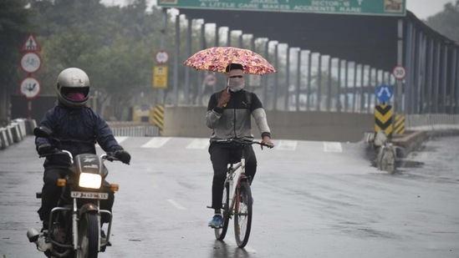
Rain Prediction – Weather Forecasting Using Machine Learning
PRESENTED BY: BHUSHAN KHUSHAL NIMJE
GUIDED BY: SAURAV KUMAR

Slide 2
CONTENT: 1. INTRODUCTION 2. DATASET OVERVIEW 3. EXPLORATORY DATA ANALYSIS (EDA) 4. FEATURE ENGINEERING 5. MODEL APPROACH 6. MODEL EVALUATION 7. CONCLUSION

Slide 3
INTRODUCTION
Accurate weather forecasting, especially rainfall prediction, is crucial for sectors such as agriculture, infrastructure planning, and disaster management, as it helps mitigate risks from natural events like floods and droughts.
The study aims to develop machine learning models to forecast rainfall using a dataset with meteorological features like temperature, humidity, wind speed, and historical rainfall data.
Four algorithms are employed: Logistic Regression, Decision Tree Classifier, Random Forest Classifier (for predicting if it will rain tomorrow), and Linear Regression, Decision Tree Regressor and Random Forest Regressor (for estimating the amount of rainfall).
By comparing these models, the project seeks to identify the most effective algorithm for rainfall prediction, enhancing the reliability of weather forecasts and aiding decision-making in weather-dependent industries.

Slide 4
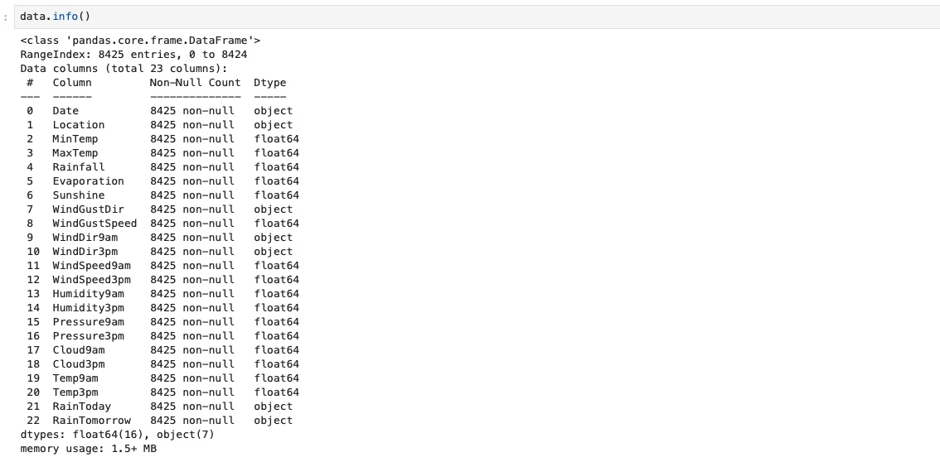
DATASET OVERVIEW
Contains 142,193 daily weather observations across 23 columns, including key meteorological features from various locations.
Key Features:
Temperature: Min Temp, Max Temp, Temp9am, Temp3pm.
Rainfall: Rainfall amount, Rain Today, Rain Tomorrow.
Humidity and Pressure: Humidity9am, Humidity3pm, Pressure9am, Pressure3pm.
Wind and Sunshine: Wind Gust Dir, Wind Gust Speed, WindDir9am, WindDir3pm, WindSpeed9am, WindSpeed3pm, Sunshine.
Outcome Variable: "Rain Tomorrow" indicates the amount of rainfall predicted for the next day, serving as the target for predicting future rainfall.

Slide 5
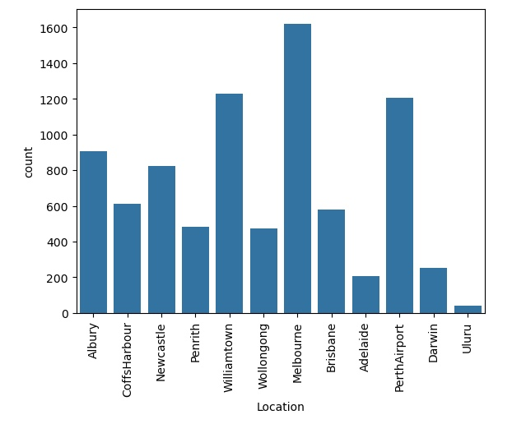
EXPLORATORY DATA ANALYSIS
As we can see that we have the highest rainfall data from Melbourne and least from Uluru.

Slide 6
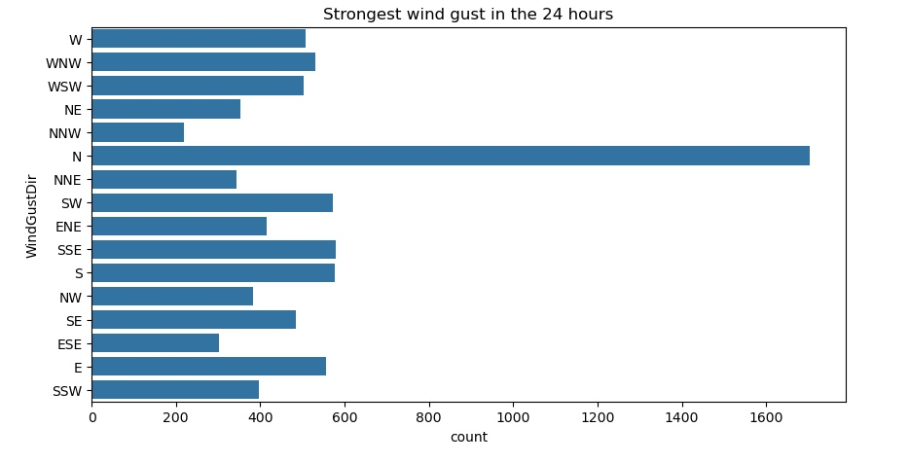
We can clearly see that the wind gust was strongest towards the north.

Slide 7
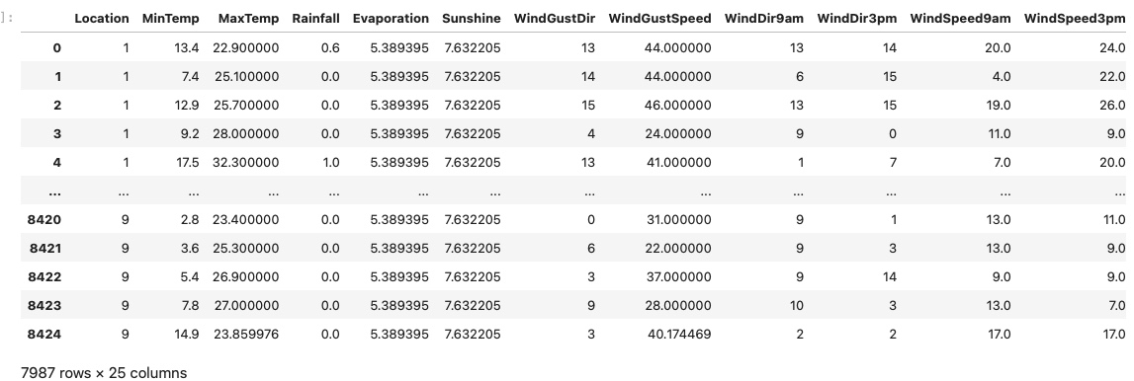
FEATURE ENGINEERING
HANDLING CATEGORICAL VARIABLES:
The dataset contains several categorical features, such as Location, Rain Today, Rain Tomorrow, Wind Gust Dir, Wind Dir 9am, and Wind Dir 3pm. To convert these categorical features into a numerical format that machine learning models can process, we used Label Encoding.

Slide 8
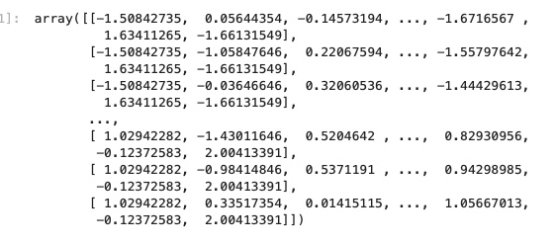
NORMALIZING AND SCALING:
Features in different units or ranges can bias the model's performance, so it’s important to standardize them. We applied Standard Scaling to ensure that all numerical features have a mean of 0 and a standard deviation of 1, which helps the model learn more effectively.

Slide 9
MODEL APPROACH
To ensure that our models are reliable and can generalize well to unseen data, we split the dataset into training and test sets. The training set is used to fit the models, while the test set is reserved for evaluating their performance. This process helps in selecting the best model and tuning hyperparameters, ultimately leading to more robust predictions.
Problem Statement a: Predicting Rain Tomorrow (Classification):-
Logistic Regression: Linear model predicting the probability of rain tomorrow based on input features.
Decision Tree Classifier: Non-linear model that splits the data into distinct classes based on feature values.
Random Forest Classifier: Ensemble method combining multiple decision trees to improve prediction accuracy through averaging.
Hyperparameter Tuning: Utilized Grid Search CV to optimize hyperparameters for Logistic Regression, Decision Tree Classifier, and Random Forest Classifier, enhancing model performance.
Problem Statement b: Predicting Rainfall Amount (Regression):-
Linear Regression: Predicts the amount of rainfall using a linear relationship between features and the target variable.
The Decision Tree Regressor can model non-linear relationships between features and the target variable. Unlike linear regression, it does not assume a linear relationship, making it versatile for capturing complex patterns in the data. Additionally, decision trees can handle both numerical and categorical data naturally, without the need for extensive preprocessing like encoding.
The Random Forest Regressor is an ensemble learning method that builds multiple decision trees and combines their predictions to produce a more accurate and stable result.

Slide 10
MODEL EVALUATION
Problem Statement a: Predicting Rain Tomorrow (Classification):-
In this problem statement I have used three classification algorithms:-
Logistic Regression which provides the accuracy of 79.27%.
Decision Tree Regressor which provides the accuracy of 74.81%.
Random Forest Regressor which provides the accuracy of 92.37%.
Problem Statement b: Predicting Rainfall Amount (Regression):-
MAE Comparison: The Random Forest Regressor had the lowest Mean Absolute Error (MAE) of 0.99, indicating the most accurate predictions, while the Linear Regression model had the highest MAE of 1.54.
MSE Comparison: The Random Forest Regressor also had the lowest Mean Squared Error (MSE) at 6.73, showing it minimized large errors better than both the Decision Tree Regressor 11.67 and Linear Regression 10.17.
R² Score: The Random Forest Regressor had the highest R² score of 0.6994, suggesting it explained the most variance in the target variable. In contrast, Linear Regression had the lowest R² score of 0.5459.

Slide 11
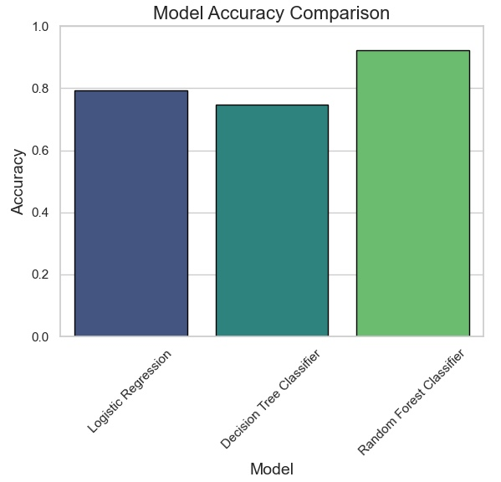
CONCLUSION
Problem Statement a: Predicting Rain Tomorrow (Classification):-
The Random Forest Classifier emerged as the best model for predicting weather it will Rain Tomorrow or not. Its ensemble approach, which combines the predictions of multiple decision trees, allowed it to capture complex relationships in the data, resulting in the most accurate and reliable predictions among the models tested.

Slide 12
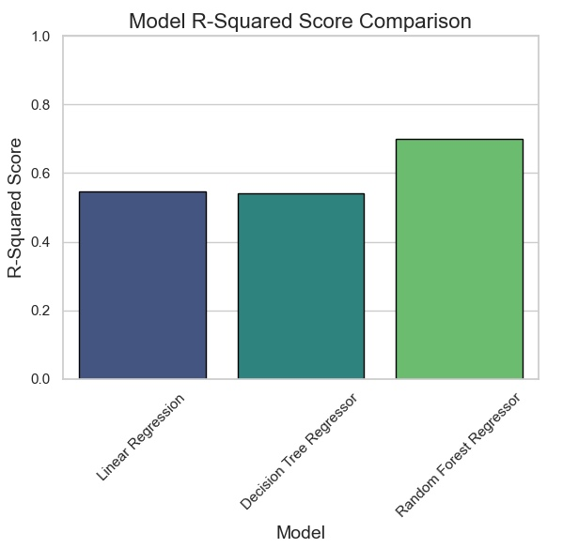
Problem Statement b: Predicting Rainfall Amount (Regression):-
The Random Forest Regressor emerged as the best model for predicting the amount of rainfall. Its ensemble approach, which combines the predictions of multiple decision trees, allowed it to capture complex relationships in the data, resulting in the most accurate and reliable predictions among the models tested.

Slide 13
THANK YOU

